Slide 2
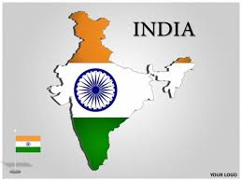
I LOVE MY INDIA

Slide 3
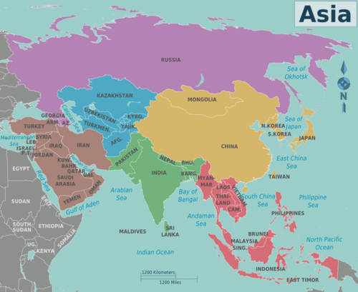
ABOUT INDIA
INDIA IS IN ASIAN CONTINENT.
INDIA IS THE SEVENTH LARGEST COUNTRY.
SECOND IN POPULATION.

Slide 4
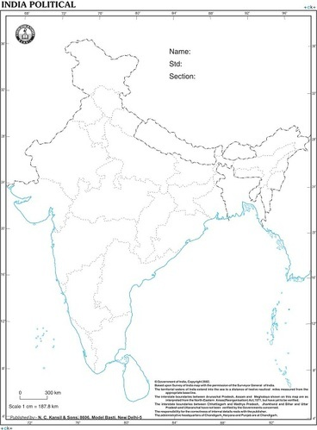
BOUNDARIES OF INDIA
NORTH - THE HIMALAYAS
SOUTH - THE INDIAN OCEAN
EAST - BAY OF BENGAL
WEST - ARABIAN OCEAN

Slide 5
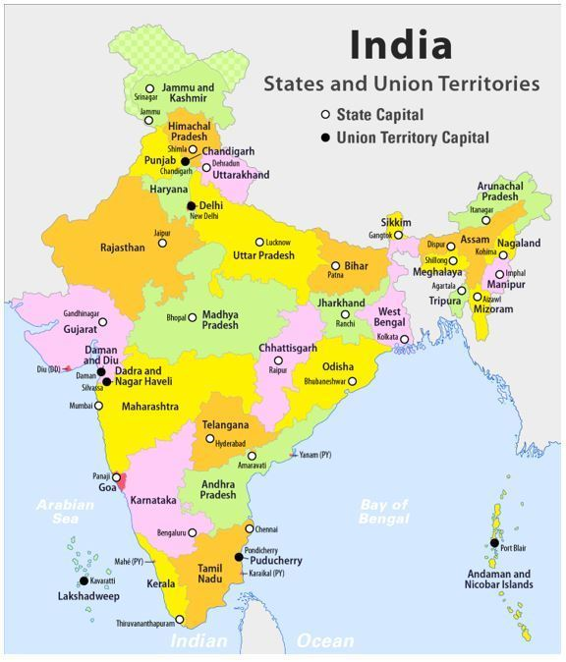
STATES AND UNION TERRITORIES OF INDIA
CONTENT SLIDE

Slide 6
POINTS TO REMEMBER
KANNIYAKUMARI –SOUTHERMOST TIP OF MAINLAND OF INDIA.
INDIRA POINT –SOUTHERNMOST TIP OF OUR COUNTRY
RADCLIFFE LINE –BOUNDARY BETWEEN INDIA AND PAKISTAN
NEIGHBOURING COUNTRIES -
PAKISTAN,AHGHANISTAN,CHINA,NEPAL,BHUTAN,MYANMAR,
BANGLADESH,SRILANKA AND MALDIVES

Slide 7
QUESTIONAIRE
INDIA IS IN WHICH CONTINENT?
WHAT IS RADCLIFFE LINE?
WHETHER BANGLADESH IS OUR NEIGHBOURING COUNTRY?
WHICH OCEAN LIES TO THE SOUTH OF INDIA?

Slide 8
POLITICAL DIVISIONS OF INDIA
INDIA IS A UNION OF 28 STATES AND 8 UNION TERRITORIES
RAJASTHAN IS THE LARGEST STATE
GOA IS THE SMALLEST STATE
SEVEN STATES IN NORTH-EASTERN STATES INDIA ARE CALLED SEVEN SISTERS
SEVEN SISTERS ARE ARUNACHAL PRADESH,ASSAM,MANIPUR,MEGHALAYA,MIZORAM,NAGALAND AND TRIPURA

Slide 9
PHYSICAL DIVISION OF INDIA
1.THE NORTHERN MOUNTAINS
2.THE PLAINS- NORTHERN AND COASTAL
3.THE WESTERN DESERT
4.THE SOUTHERN PLATEAUS
5.THE ISLANDS

Slide 10
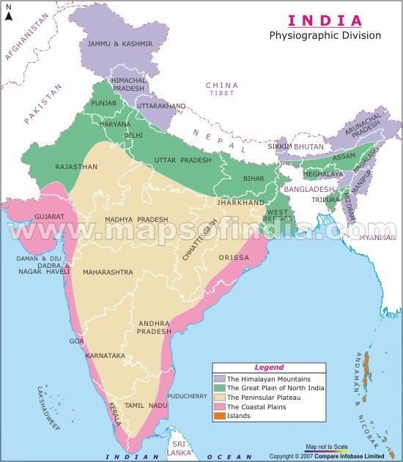
CONTENT SLIDE

Slide 11
QUESTIONAIRE
WHICH IS THE LARGEST STATE?
HOW MANY PHYSICAL DIVISIONS ARE THERE IN INDIA?
WHICH STATE HAS TWO CAPITALS?
NAME THE STATES OF SEVEN SISTERS.
NAME THE NATIONAL CAPITAL TERRITORY OF INDIA.

Slide 12
https://youtu.be/BJpUtHbU8O4-
Reference video url

